Slide 1
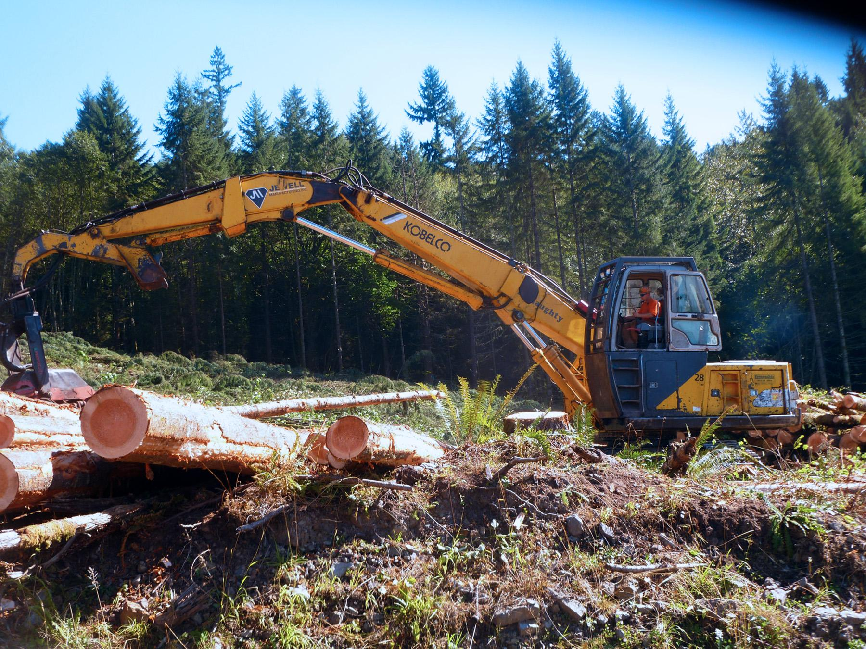
Oregon Logging Accidents: Ten Years of Data,
Fifty Years of Perspective
Dr. John J. Garland, PE
Consulting Forest Engineer,
Affiliate Professor,
Pacific Northwest Agricultural Safety & Health Center, University of Washington,
Professor Emeritus, FERM, Oregon State
Notes:
EXAMPLE USE OF TITLE SLIDE

Slide 2
Introduction
Logging accidents result from behaviors and conditions
Data on logging accidents show results, attributes, and trends not necessarily the cause
Data are reviewed on ten years of 2,207 accepted claims by Oregon’s Workers Compensation system
Accidents are predictable and probabilistic
Data with perspectives gives interesting insights
Notes:
INTRODUCTION – Slide 2
Logging accidents result from specific behaviors such as lack of adherence to safety protocols, fatigue, and inexperience, as well as conditions like poor weather and equipment failure, both prior to and at the time of the accident.
Data on logging accidents show results, attributes, and trends, but they are not necessarily the cause.
Research based on data (reviewed on ten years of 2,207 accepted claims by Oregon’s Workers Compensation system), but also on the author’s fifty years of experience as a researcher, educator, and litigation expert. This hands-on experience, gained from doing the actual jobs and from a global perspective, will give you confidence in our findings and future directions.
Accidents are predictable and probabilistic; examples are given.
By combining the data on logging accidents with the author's perspectives, interesting insights and directions for the future in preventing logging accidents can be derived. This unique blend of data and personal experience provides a comprehensive understanding of the issue and paves the way for effective preventive measures.

Slide 3
Example Studies
National, provincial, regional or local scale
Statistics by federal or state agencies, insurance organizations, associations
Hospitalizations coded occupation available
Investigations by OSHA, accident prevention organizations, labor and industries, insurance, logging, associations, hospitalizations, emergency responders and police reports.
Accident reporting mandated by laws/regs, contracts, voluntary
Codes assigned at investigations or later from descriptive materials.
Notes:
EXAMPLE STUDIES Slide 3
As forestry professionals, safety and health agencies, insurance organizations, and researchers, your role in understanding and utilizing the data on logging accidents is crucial.
These studies may be on a national, provincial, regional, or local scale, each providing a unique perspective and depth of understanding on the issue of logging accidents.
Statistics are kept over a period by federal or state agencies.
At times, insurance organizations or associations provide data such as the number of claims and severity of injuries, and sometimes hospitalizations coded by occupation are available.
These sources provide a comprehensive view of the logging accident landscape, such as occupational safety and health agencies (OSHA), accident prevention organizations, labor and industries agencies, insurance investigators, associations, hospitalizations, emergency responders, and police reports.
Laws and regulations sometimes mandate accident reporting.
Reporting may have codes assigned during investigations or assigned later from descriptive materials.

Slide 4
Data or Variables Collected
Occupation, source of injury, body part injured, age, event, nature of injury, time of injury, day of week, experience
Time with employer, training, description of circumstances, insurance status of firm, region/county, firm size
Forest ownership, claim status, professional/occasional worker, mechanized/manual logging, PPE, location details
Other, e.g., special topic of interest
Notes:
DATA OR VARIABLES COLLECTED Slide 4
The data collected by incident is directly relevant, as it includes such variables as occupation, source of injury, body part injured, age, event, nature of injury, time of injury, day of week, experience, time with employer, training, description of circumstances, insurance status of firm, region/county, firm size, forest ownership, claim status, professional/occasional worker, mechanized/manual logging, PPE, location, and other, e.g., particular topic of interest.

Slide 5
Authors & Publications
Studies by surveillance specialists, safety and health researchers, ergonomists, economists, medical researchers, forestry safety researchers, students/professors, agencies
Peer reviewed journal publications in medical, safety & health, and forest engineering, trade journals, agency reports, insurance summaries
Special organizations, e.g., PNASH, FACE, other centers, associations e.g., AOL, FRA, THAT’S
Studies are reported by surveillance specialists, safety and health researchers, ergonomists, medical researchers, forestry safety researchers, students and their professors, and agency researchers
Notes:
AUTHORS & PUBLICATIONS Slide 5
Because logging accidents are frequent over time, the numbers provide a robust database for analysis, especially if time series data are available. Data can be collected for logging injuries or fatalities and, in some cases, for forestry services if covered by accident reporting. Surveillance specialists, safety and health researchers, ergonomists, medical researchers, forestry safety researchers, students and their professors, and agency researchers report data in studies. Publication occurs in medical, safety & health, forest engineering, and other peer-reviewed journals; trade journals; agency reports; insurance summaries; special organizations, e.g., PNASH, FACE, and other centers; associations, e.g., AOL; and proceedings, e.g., COFE, ISASH, others.

Slide 6
STATISTICAL REPORTS SHOW THE
RESULTS OF ACCIDENTS
NOT THE CAUSE OF ACCIDENTS.
Studies are reported by surveillance specialists, safety and health researchers, ergonomists, medical researchers, forestry safety researchers, students and their professors, and agency researchers
Notes:
STATISTICAL REPORTS SHOW THE RESULTS OF ACCIDENTS – NOT THE CAUSE OF ACCIDENTS Slide 6
Some issues with the data collection to keep in mind is that the data is not complete because self-employed individuals and those without insurance coverage are missing. Firm size may be limited, e.g., to firms >10. Events involving trees may be classed as logging while they are arborist or rancher/ farmer/ homeowner injuries. Incomplete descriptions may result in miscoding later. The high number of “logging laborers, NEC” in counts shows the problem. Finally, all data is dependent on the skill of the initial investigator. The statistical reports identify the accident’s results, not the accident’s cause. Here are some results of a data set from Logging Accepted Disabling Claims in Oregon, 2013-2022: Statistics Division, Department of Consumer and Business Services recorded 2,207 accepted claims for injuries. Let us examine the results in the following slides:
What is the injury event? Slide 7
Who gets hurt? Slide 8
What are the injuries? Slide 9
What is the source of the injury? Slide 10

Slide 7
Notes:
What is the injury event? Slide 7

Slide 8
Notes:
Who gets hurt? Slide 8

Slide 9
Notes:
What are the injuries? Slide 9

Slide 10
Notes:
What is the source of the injury? Slide 10

Slide 11
VILFREDO FEDERICO DAMASO PARETO 1848-1923
The Pareto Principle was named for
Vilfredo Pareto who observed
“80% of results come from
20% of effort/time”
Studies are reported by surveillance specialists, safety and health researchers, ergonomists, medical researchers, forestry safety researchers, students and their professors, and agency researchers
Notes:
VILFREDO FEDERICO DAMASO PARETO Slide 11
The data displays indicate where safety improvements might be addressed. When data are displayed in a similar way, it is apparent to me that injuries follow a “Pareto-like” form. Pareto famously said, “80% of results come from 20% of effort/time.”

Slide 12
Logging Accidents are Predictable
and Probabilistic
PREDICTABLE: In the Clear; Pulling wrappers w/o load securement
Regulations written to address predictable events
PROBABILISTIC: “Widowmakers”; Rare Events
Awareness of Rare Events: “Always have a hole”
Notes:
Logging accidents are both predictable and probabilistic. Compared to other industries with controllable workplaces, logging takes place in difficult, steep terrain, trees and logs are big and heavy, machinery to handle the material is big and complex, dangerous chainsaws are used, manual work is on muddy, steep and slippery surfaces, and weather factors into the work. Health hazards from repetitive motion, poisonous plants, snakes and insects are part of the work environment. People working in difficult, dirty, dangerous and declining industries may only receive on-the-job training where unsafe practices are passed on. While trends in the number of accidents show improvements, logging accidents predictably continue. Slips, trips and falls continue on logging surfaces. Logs fall off loads when precautions are bypassed. Trees fall and logs move in unexpected ways during harvest. Woods roads are not safe city streets. Various cultural influences contribute to accidents. When workers are not “in the clear” during operations, accidents will eventually happen. Safety regulations are written to cover the predictable accidents.

Slide 13
Implications of Probabilities
Notes:
The probabilistic nature of logging accidents is not well understood. Incident rates over time provide some guidance. High numbers of workers injured in the first 30-90 days of employment may indicate training and supervision deficiencies. Greater exposure to identified hazards for choker setters and timber fallers suggests greater safety efforts for those occupations. Histories of accident increases while harvesting after windthrow or fire events provide future guidance for precautions. A greater frequency of accidents on Monday and Friday of the work week offers speculative solutions not including only working Wednesday through Thursday. Increasing accidents over time by workers, 55-64 and greater, may simply reflect that workers are scarce and older workers are staying in the workforce longer.

Slide 14
Rare Events Need Explanation
Example:
“Plastic wrap, tarps and sheeting” show 7 incidents. How?
“Bakers sliced” by a “knife” - In logging incidents?
Managers have safe positions, being “shot by coworker” and events describing “hitting, beating, kicking, shoving” by co-worker isn’t safe. Is this our workforce?
“Heat stroke” and “heat syncope/sickness” Oregon has stiff regulations in all industries for costly & impractical compliance.
“Hypothermia” w/”cause” of “cold environment” show 2 incidents in data.
Notes:
The Rare Events seen in accident reports demand a deeper level of investigation than what is currently provided in the brief descriptions in databases (Logging Accepted Disabling Claims in Oregon, 2013-2022, Statistics Division, Department of Consumer and Business Services). This is a call to action for all safety and risk management professionals, accident investigators, and policymakers in the field of workplace safety.
Should data be questioned when it presents such unusual occurrences?
How "Plastic wrap, tarps and sheeting" could account for seven incidents of lost time accidents.
Why are “Bakers” who are “sliced” by a “knife” appearing in logging accident reports? This incongruity requires explanation.
While first-line supervisors and managers are typically in safe positions, the occurrence of a “shot by a coworker” incident is “highly unusual" and warrants further investigation.
Another incident description is "hitting, beating, kicking, shoving" by the "Source of a Coworker.” Considerations might be: Is the workforce changing?
The incident of "heat stroke" and "heat syncope (sickness)" represent two incidents, yet Oregon has stiff regulations covering this type of incident. Logging is swept up with farming and all industries for costly and impractical compliance.
The incident of “hypothermia” with a cause of “cold environment” similarly has two incidents in the data.

Slide 15
2005 To 2014 Claims Rates Were 46.4/100FTE In Non-Mechanized Logging Versus 6.7/100FTE (Bonauto, et al, 2019)
Notes:
TESTING HYPOTHESES WITH DATA SET ANALYSIS
There are practical uses of accident data sets for testing hypotheses if researchers understand the questions to ask and the data cover the population and events. One such question is “Does mechanization of logging change the frequency and type of injuries?” In 2019, Bonauto et al., reported in "2005 To 2014, Claims Rates Were 46.4/100FTE In Non-Mechanized Logging Versus 6.7/100FTE" that mechanized logging with changes in traumatic injuries and cost of claims as well. These reliable findings were supported by a large data set and the coverage of the population was significant. In 2022, Bell, et al., and in 1998, Axxelson, reported similar findings. Example hypotheses typically evaluated were:

Slide 16
No Difference Between Age Groups of Loggers: Younger Loggers Have More Accidents Than Older Loggers
Notes:
There is no difference between age groups of loggers: younger loggers have more accidents than older loggers. Slide 16

Slide 17
No Difference Between Accidents of Experienced/ Inexperienced Loggers: Inexperienced Loggers Have More Accidents
Notes:
There is no difference between accidents between experienced and inexperienced loggers: inexperienced loggers have more accidents than experienced loggers. Slide 17

Slide 18
2005 To 2014 Claims Rates Were 46.4/100FTE In Non-Mechanized Logging Versus 6.7/100FTE (Bonauto, et al, 2019)
Notes:
It's important to note that while rejecting the null hypothesis doesn't directly reveal the underlying factors, it does provide an opportunity for further exploration. Researchers well-versed in the logging industry may propose factors, causes, and trends that could potentially yield results. However, it's important to remember that these are just possibilities. To validate their significance, additional trials and research are required, ensuring a comprehensive approach to understanding the data. Regarding the potential relationship between the reduction in cutting incidents over time and the introduction of steep slope tethered logging, it's worth noting that steep slope cutting is highly productive, with a single hour of mechanical cutting equivalent to four hours of manual felling. Data on machines for steep slopes is available from ongoing ORSHA variance reporting. The graph indicates a decrease in cutter injuries from 2013 to 2022, coinciding with an increase in the number of steep slope machines. This is an interesting observation, but it comes with at least one caveat: most cutting is carried out by fallers not covered by WCB, and they may have experienced increased injuries while cutting difficult areas not machine-cut. Additionally, machine cutting without tethering has also increased, contributing to safety concerns. Changes in cutter competence may also have played a role, as indicated by anecdotes. Slide 18 (same as 15)

Slide 19
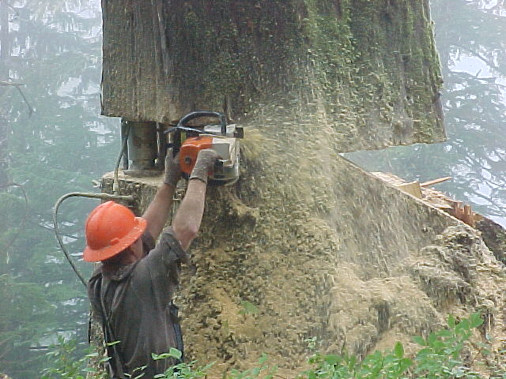
DOES THE RESEARCHER’S PERSPECTIVE
INFLUENCE ACCIDENT ANALYSIS?
Notes:
HOW DOES THE RESEARCHER’S PERSPECTIVE INFLUENCE ACCIDENT ANALYSIS? Slide 19
Fifty years ago, the trees were typically six feet in diameter and 250 feet tall. Fallers used saws with 6-foot bars, and the bull buck had a saw equipped with an 8-foot bar and a handle on the end to support and guide the bar. The yarders were huge, with 1-inch chokers and D8 cats logged flat on the ground. The Weyerhaeuser camps on Coos River each put a million board feet in the water daily to raft downriver to the World’s most extensive lumber shipping facilities. Timber barons drove Cadillacs, but workers drove new Fords and Chevies.

Slide 20
HOW DOES THE RESEARCHER’S PERSPECTIVE INFLUENCE ACCIDENT ANALYSIS?

Slide 21
Current fatalities in the single digits reflect cumulative improvement in technology & safety management. Oregon safety codes responsible and tethered steep slope logging.
Fatalities as “rare events” difficult in safety management unless “near misses(hits)” are part of metrics.
Studies are reported by surveillance specialists, safety and health researchers, ergonomists, medical researchers, forestry safety researchers, students and their professors, and agency researchers
Notes:
CURRENT FATALITIES Slide 21
The transition to small timber harvest with Scandinavian machines in thinning and the corresponding change in safety over time. The graph of fatalities in Oregon from 1945 has different meanings.
In 1950, Oregon’s logging fatalities peaked at 90 loggers. The high harvest levels were required to meet the housing needs of WWII veterans.
One significant event that shaped the industry was the October 12, 1962, Columbus Day Storm. This storm, known as the greatest windstorm in Pacific Northwest, recorded weather history, led to the harvesting of windthrown trees from roadways. It struck Washington and Oregon with the power of a Category 3 hurricane, leaving dozens of dead. The dip in fatalities (20 logger fatalities per year) that followed this storm is a clear indication of the impact of such events on the industry.
In 1973, 37 loggers lost their lives at work.
The 1981 drop, 12 loggers lost their lives in fatalities coinciding with the recession that also reduced harvest levels, and the upturn afterward could be due to startup firms returning to business with new employees.
The 1992 drop in fatalities, with four loggers losing their lives, directly resulted from the reduction in harvest levels from Clinton’s Forest Plan. This plan significantly reduced USFS harvests to minuscule levels, thereby reducing the risk of fatalities.
From the middle 1990s, two to four loggers per year lost their lives. These reductions may reflect the increasing mechanization of harvesting smaller timber.
Today, the number of fatalities has significantly reduced to two loggers per year, a testament to the cumulative improvement in technology and safety management. Oregon safety codes, particularly those governing tethered steep slope logging, have played a significant role in this reduction. It is important to note that some fatalities are “‘rare events’” that are difficult to address unless “near misses/hits” are part of the metrics. However, overall, the industry is making significant strides in improving safety.

Slide 22
PERSPECTIVE ON “RARE EVENTS,”
PROBABILITY AND CAUSES
FOLKLORE: “Freak Occurrence,” “Act of God,” “Unavoidable Catastrophe,” “Bizarre Event,” inexplicable events happen
“I guess it was just his time.” Reflections on our mortality
Separate “proximate cause” identified and predictable
From the “effect” with a probabilistic nature
Notes:
PERSPECTIVE ON “RARE EVENTS,” PROBABILITY AND CAUSES – Slide 22
There is folklore among loggers to characterize accidents they cannot understand as: “Freak Occurrence,” “Act of God,” “Unavoidable Catastrophe,” “Bizarre Event,” or something similar. They reflect on their mortality with “I guess it was just his time.” Saying it was a “Random Event” does not deal with probabilities.
Detailed accident investigation involves separating the proximate cause of the accident from its effect, which is problematic.

Slide 23
First Chain Shot: Rare Event
Surgery to remove an object from spleen
A “chain shot” link from broken chainsaw chain
Proximate cause difficult to identify: manufacturers denied chain shot occurred
I viewed hours of high-speed chain breaks & found one segment with chain shot for manufacturer; first time
Skogforsk--2 chain shots for every 50 breaks of a machine chain as probability
Regulations, warnings, engineering controls now
Notes:
Here are several examples:
A worker was taken to surgery to remove an object from his spleen. Turns out it was a “chain shot” link from a broken chainsaw chain. The proximate cause was difficult to identify as manufacturers denied that the chain shot had occurred. After viewing hours of high-speed chain breaks, a segment showed a chain shot. The cause was identifiable; the estimate is now two chain shots for every 50 breaks of a machine chain, and regulators and manufacturers have addressed the issue. The effect of a chain shot is a rare event, but rare events happen, and without surgery, this incident would have gone unnoticed. Slide 23

Slide 24
CUT TREE FALLS ON TIMBER BUYER
Longleaf pine fell into neighbor’s yard from harvest operation. Killed timber buyer
Rare event that person struck: 1 in a million type odds.
Cause predictable for feller buncher cutting trees too large for saw
Prior “barber chairs” and stump pulls indicated loss of control.
Testimony/analysis had trees beyond capacity and control
Low probability effect with predictable cause that could have been prevented.
Notes:
A timber buyer in the neighbor’s yard next to a harvest operation was checking boundaries and was struck by a Longleaf pine that fell into the yard from the operation. It was a rare event that the tree struck the person with one in a million type odds. However, the cause was predictable: the wheeled feller buncher was cutting trees too large for the saw opening, and prior “barber chairs” and stump pulls indicated a loss of control. Testimony and analysis showed that the trees were beyond the machine’s capacity. This event could have been prevented because of its identifiable cause and a low probability effect. Slide 24

Slide 25
FALLING TREE STRIKES MOVING VEHICLE
Forester driving 25 mph struck by tree falling precisely onto the moving truck. Odds tree would hit vehicle to low to contemplate.
Losing control of tree predictable from failed cuts at the stump.
First back cut too low for undercut facing uphill away from the road.
Another back cut above first, negated effects a wedge provides to make leaning tree go up the hill. Coming over backwards was predictable.
Forester told to wait at flagger location miles away until clearance given.
Driver decided enough time passed and drove on into harm’s way . . . matter of seconds for different outcome?
Accident investigations had many opinions/conclusions . . . mostly wrong.
Notes:
An agency forester driving at 25 mph on a wooded road was struck by the top of a tree that fell as her vehicle came into the path of the tree. The odds that the tree would hit precisely as the vehicle passed are too low to contemplate. However, losing control of the tree was predictable from the failed cuts at the stump. The first back cut was too low for the undercut, facing the tree uphill away from the road, and making another back cut above the first negated any effect a wedge could make to bring the leaning tree up the hill. Coming over backward was predictably inevitable. The forester was told to wait at a flagged location miles away until given clearance but decided enough time had passed and drove on into harm’s way. A matter of seconds would have had a different outcome. Accident investigations had all manner of opinions and conclusions that were mostly wrong. Slides 25 and 26

Slide 26
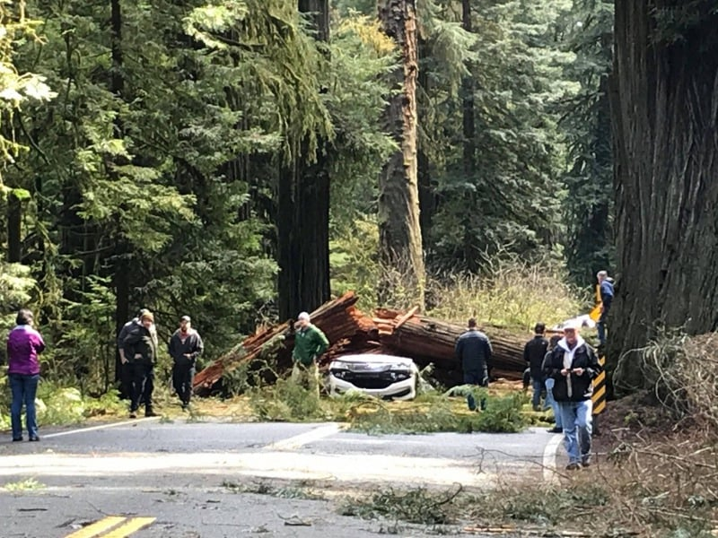
TREES FALLS ONTO HIGHWAY: TOTAL COLLAPSE

Slide 27
TREES FALL ONTO HIGHWAYS
When trees fall onto highways and kill bystanders, events are NOT “Acts of God.”
Prior evidence of tree failure in the area from dents in the guard rail, adjacent downed trees, or blown out tops.
When incident trees show root rot or butt rot, prevailing wind events, slope, or lean will cause trees to fall across highways.
A large old growth tree with only a ring of solid wood at the base will inevitably suffer a “total tree collapse” when the strength of the tree to hold it upright is less than the forces for failure. Hard to predict the probable failure zone.
Highways with high traffic rates are not low probability targets.
A dark and stormy night on a curvy well traveled highway removes the rare event probability idea for driving into a downed tree or being struck by one or more windthrown trees.
Notes:
Similarly, several cases where trees fall onto highways and kill passersby are termed “Acts of God.” Not so. In several cases, there was prior evidence of tree failure in the area from dents in the guard rail or downed trees that did not hit the road. Upon initial investigation, evidence of a prevailing wind event acting on trees minimized by slope or lean which is made worse by root rot or butt rot, causing the tree to fall across the highway. A large old-growth tree with only a ring of solid wood at the base will inevitably suffer a “total tree collapse” when its strength to hold it upright is less than the forces for failure. It is hard to predict the probable failure zone. So, trees will fail. Highways with high traffic rates are not low probability targets compared to woods roads. A dark, stormy night on a curvy, well-traveled highway removes the rare event probability of driving into a downed tree or being struck by one or more windthrown trees. Slide 27

Slide 28
CONTRIBUTING FACTORS FROM LITIGATION INVESTIGATIONS
Cultural differences and influences
Social hierarchies and communications
Confessions at later date of wrongdoing
Understanding risk taking behaviors
Notes:
Detailed accident investigation in litigation can discover contributing factors that may help prevent future incidents. For example, how can cultural differences between Hispanic and Gringo workers put some in the clear while others are below felled and bucked timber that moved unexpectedly? How strongly should a choker setter tell the rigging slinger that he could see he was too close to the turn if logs upended and did strike him? Why did the faller tell investigators months after the incident that he just meant to fall a short snag to scare his relative and his mentor, but that it exploded, and a chunk injured his partner, who later died? Injured workers may add insight into accident investigation by carefully listening to risk-taking admissions during the initial stages of the investigation.
Upon initial investigation, evidence of a prevailing wind event acting on trees minimized by slope or lean which is made worse by root rot or butt rot, causing the tree to fall across the highway. Slide 28

Slide 29
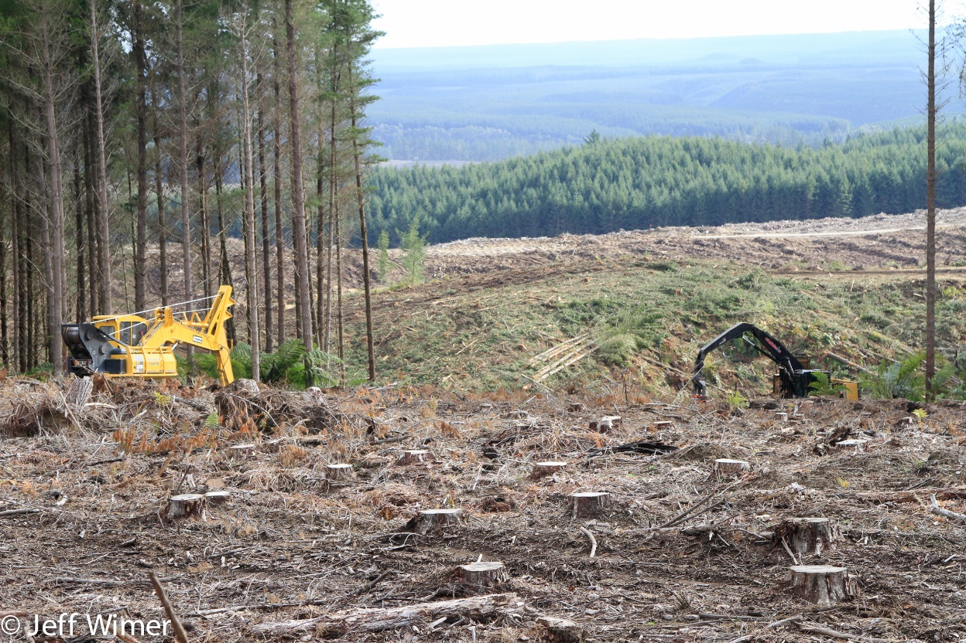
CONCLUSIONS
 | Hopes, Desires, Goals, Expectations, Optimism Systematic/predictable accidents have potential for improvement “Rare Event” accidents require assessing “near miss (hits)” How to do this? Incident compilations show results of accidents not cause Deeper analysis, post event interviews, special studies needed Teamwork between surveillance and logging experts can improve understanding and knowledge
Notes:
CONCLUSIONS – Slide 28
In Oregon, systematic safety failures are recognized, and when implemented rules and regulations aimed at reducing injuries and fatalities in the logging and forestry industry are effective. For instance, incidents like logs falling from trucks onto drivers are not uncommon. The efforts to reduce these “rare event” incidents will require assessing the near miss (hits) events for their underlying causations, which may be rooted in complex human behaviors. There is no clear strategy to accomplish this task.
The compilation of fatal and injury incidents records the results from logging and forestry services. Data does not provide the causes of the incidents, and deeper accident analysis is needed than what is often the situation. Your expertise, as surveillance, safety, and medical researchers who often publish on the various agency data sets, is invaluable. Teaming up with knowledgeable logging and forestry services experts for data interpretation, conclusions, and hypotheses to test, you can make a significant contribution to improving safety in the industry.

Slide 30
THANK YOU!

